Slide 1
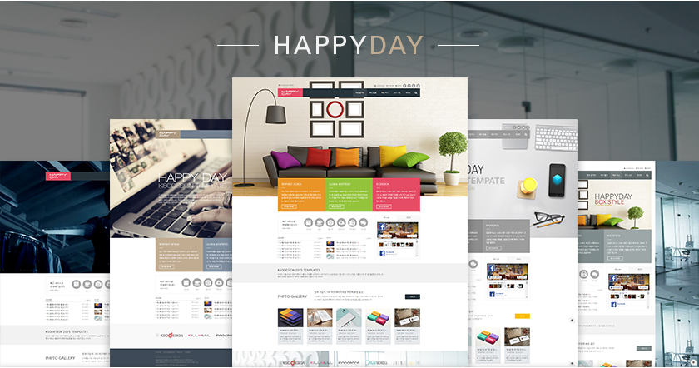
http://ksodesign.com/product_happyday

Slide 2
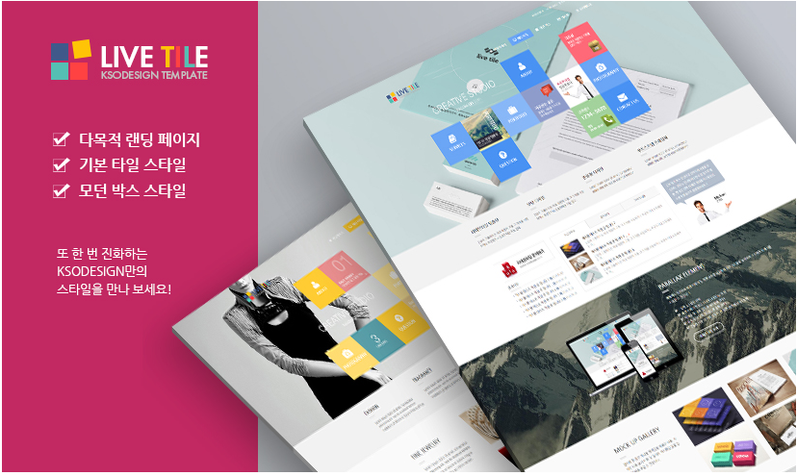
http://ksostudio.com/project/lt_home1

Slide 3
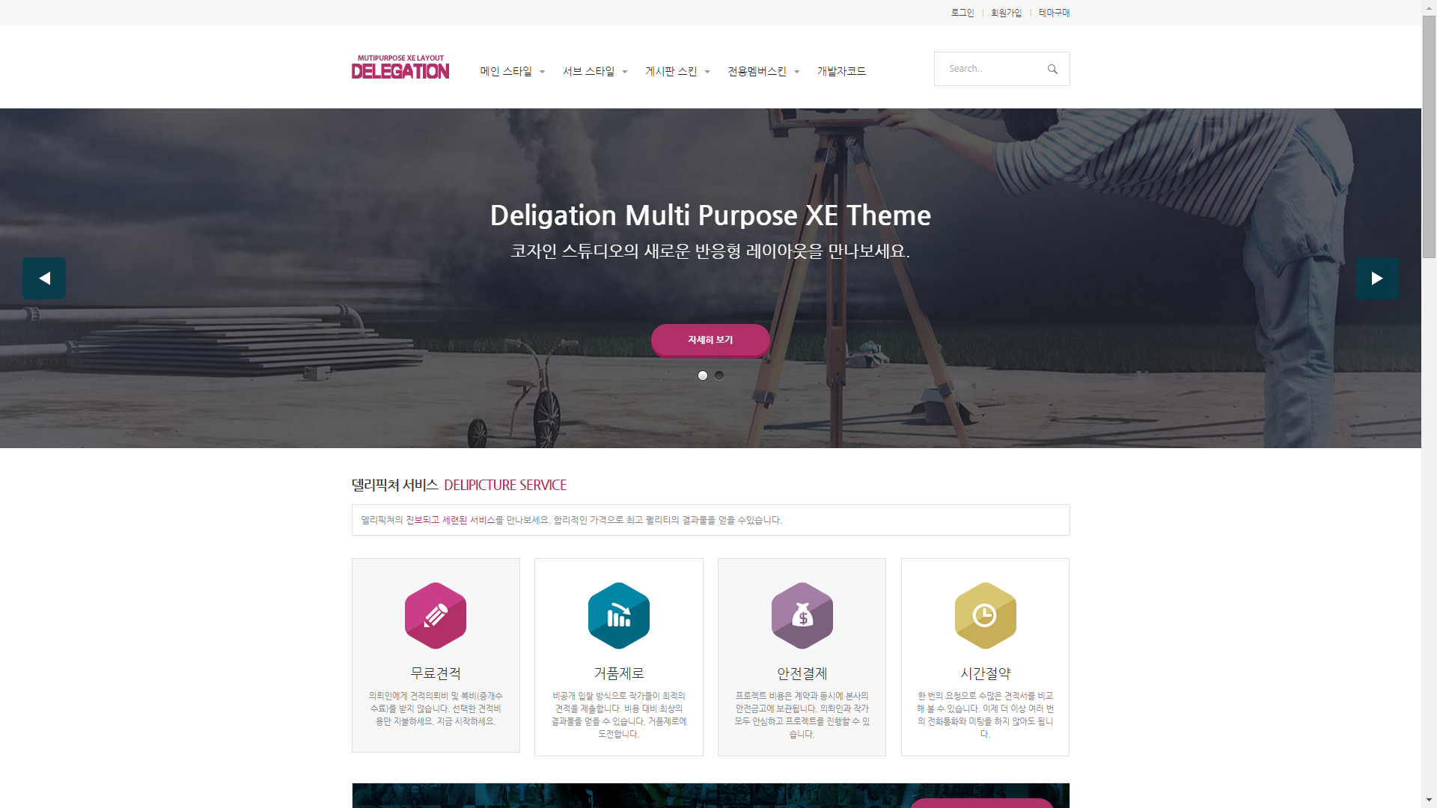
http://codesignlab.cafe24.com/deligation_main4

Slide 4
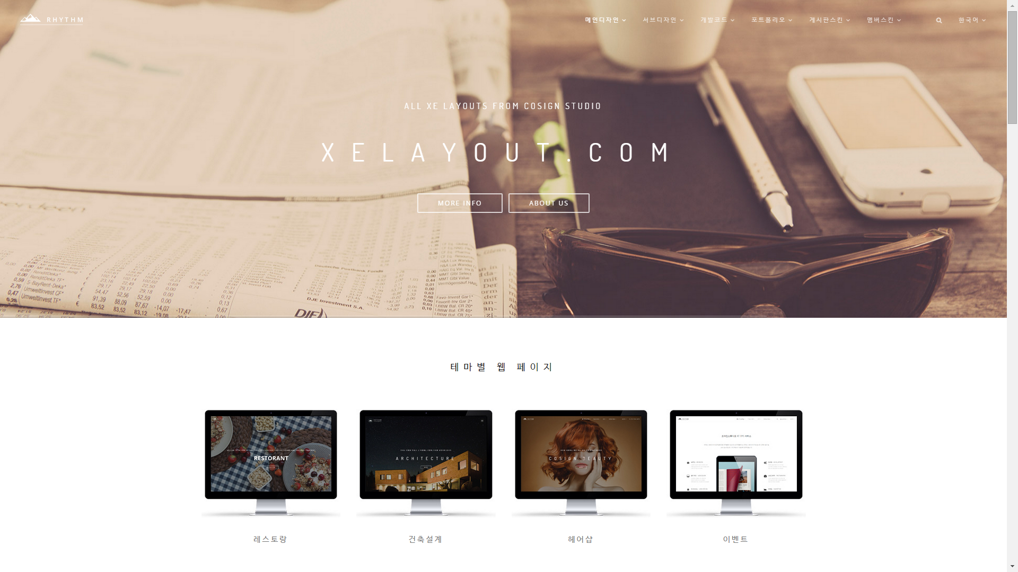
http://codesignlab.cafe24.com/rt_intro

Slide 5
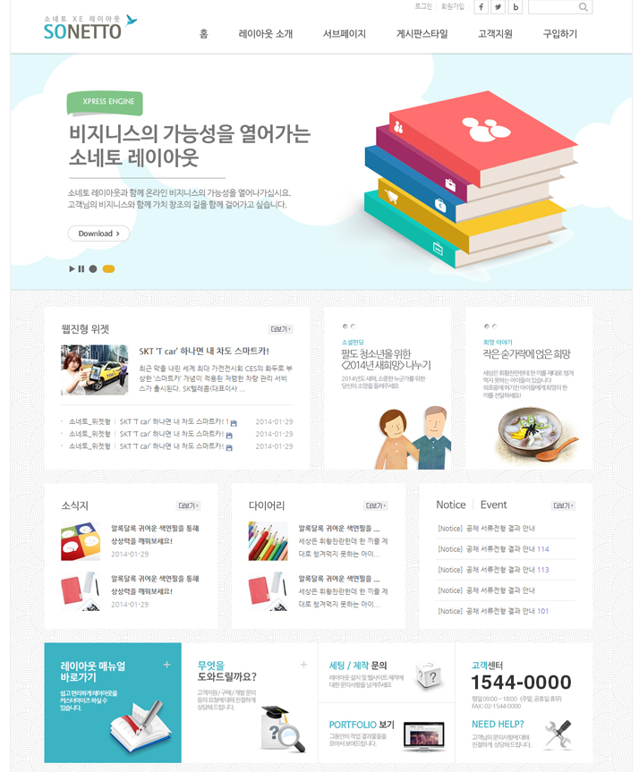
http://cousinshin.cafe24.com/sonetto_home

Slide 6
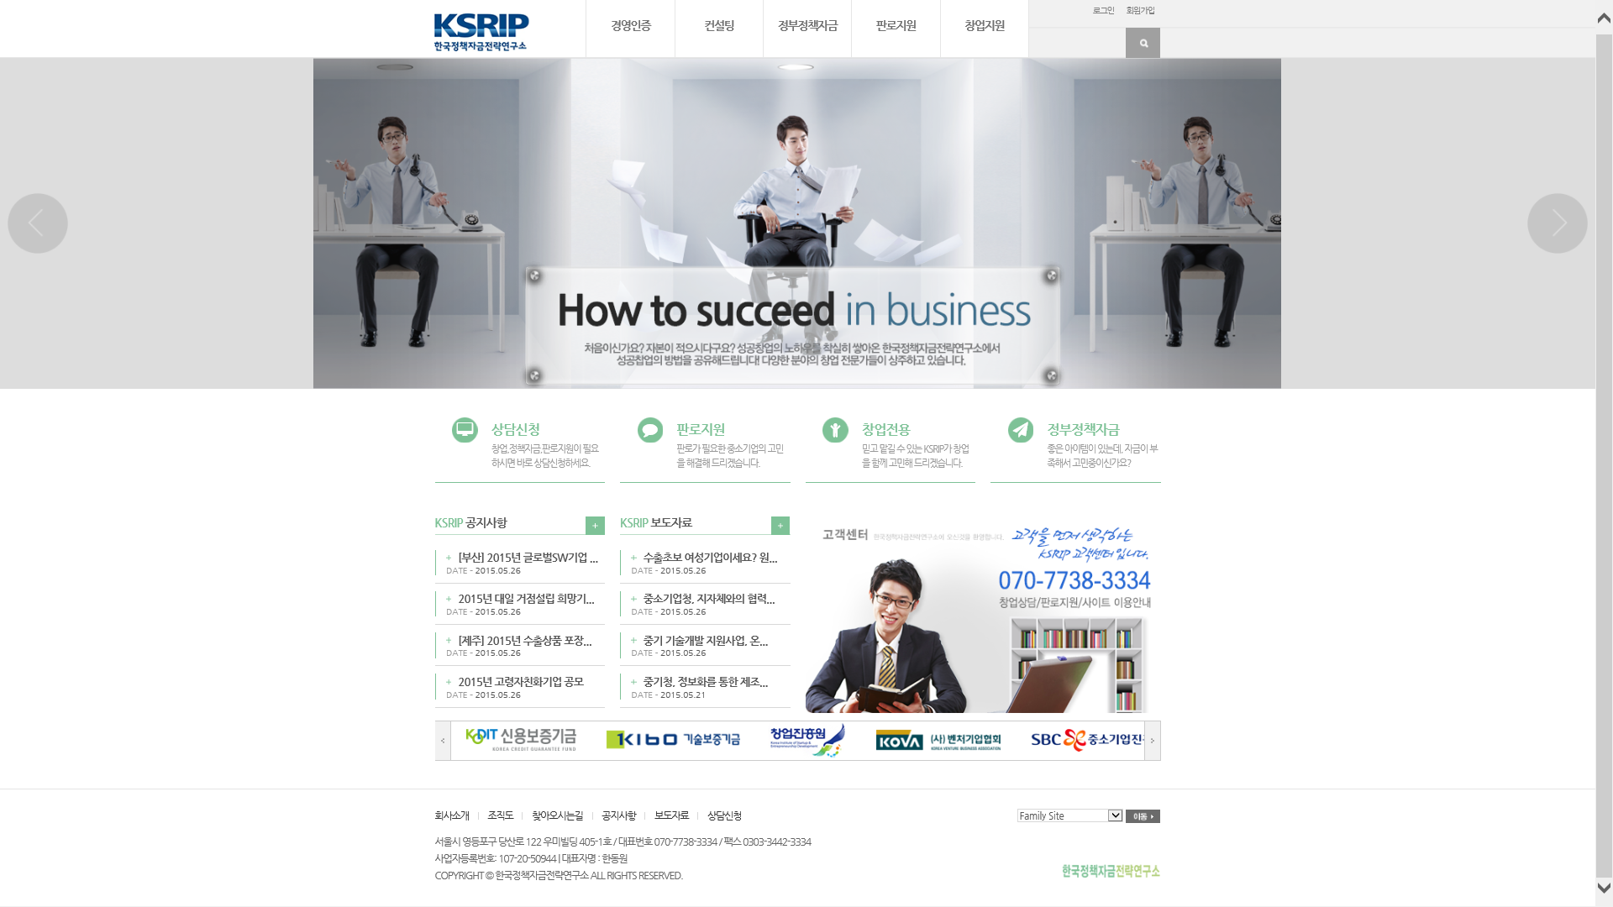
http://ksrip.com/

